Slide 1
Bookaholic Business Canvas

Slide 2
Customer Segments
Book enthusiasts
Bloggers and Authors
Developers
There is a facility so that book enthusiasts can rate, review and order books. They will be around 80% of the customer segment as the vast majority will join as free tier users which will at most buy books to support monetization.
This segment refers to 15% customers which will go further in investing into the platform by acquiring a premium tier account in order to have access to a blog, a method of publishing books online eventually and the Advisor.
The last 5% of the customers will most probably sustain the platform by acquiring API subscriptions for the content which backs the main application. The CAAS value of the platform is viable as the business model gathers a lot of data which can be exposed further.

Slide 3
Value Proposition
Books
Advisor
The Advisor
Publishing opening
Robust content
Robust content
As a core of the platform, dedicated mostly to the free tier users, the books will represent a very big part of the revenue. This is in fact very flexible in terms of offering discounts and advertising.
A unique feature which will bring great value proposition. This will use AI in order to serve an user a suggestion and eventually a discount for a specific book.
A powerful platform for newbie authors which want to publish a book without any classic publisher overhead. This is in fact what really makes Bookaholic unique in terms of features.
At the opposite side, the robust content is released to the developers for supporting continuous grow of the lecturer community.

Slide 4
Channels
Main website
Book delivering
Backdoor website
The content will eventually be delivered through the website (the advises, the publishing method is exclusively online etc.). There will be a online hosted website which will deliver all these features.
This is the most physical channel meaning that it requires storage and couriers for such channel as the books ordered are sold in physical format.
The last channel is exclusively for the developers. This is the way they can reuse the content: through a “backdoor” website which will deliver the gathered content.

Slide 5
Relationships
Mass customers
Built-in “Lock-in”
Built-in “Lock-in” - Dev
The default relationship will be established with the free tier users which will have access to all kind of information and eventually be able to buy books. These are considered mass as there is no specific individuality to the each of them as long as they do not go for a premium tier.
For special customers (premium tier) there is a rather more specific relationship as they have a more personalized environment. While the bloggers may be seen as mass customized due to their diverse blogs, the authors are built-in “lock-in” as they will exclusively use the platform for publishing their books.
The dev part is rather different from the customer mass which use the application only for accessing on surface features. This relationship is established with developers which rely on our content in order to grow their company, thus they are seen as “lock-in”.

Slide 6
Revenue streams
Periodic book selling
Premium account
API Subscription
The free tier users can contribute to the platform in terms of revenue only by buying books. This is a bonus income towards the sustainable continuous streams as the other two. However this targets the most amount of users.
The premium account is a sustainable revenue stream as it is based on monthly/annual subscriptions for bloggers and authors. There is also flexibility in terms of book publishing where the way of taxing is similar to the cloud services.
The API subscription is dedicated for the devs, which will pay for a subscription in order to use the content. The subscription is granted on a fee for a limited time, thus there is not necessary a continuous flow of money.

Slide 7
Key resources
Developing platform
Software developers
Storage
The developing platform is part of the core of the application as it influences the wellbeing of the application. This will be served by Microsoft Azure, as the application will be built ultimately on the support provided by the cloud service.
The premium account is a sustainable revenue stream as it is based on monthly/annual subscriptions for bloggers and authors. There is also flexibility in terms of book publishing where the way of taxing is similar to the cloud services.
A way of storage for the physical books is required. There are several way books should be delivered thus there must be a way to storage all these books bought or manufactured beforehand.

Slide 8
Key activities
Maintenance
Marketing
The Advisor
Distribution
Robust content
Manufacture
The application will need for sure maintenance as it is a continuously growing application which is not necessary autonomous on its own.
The marketing part is evident as the application implies selling books supported by publishers or created by our company.
The distribution is triggered by the well being of the marketing. As long as the marketing work, the distribution is mandatory in order to deliver books to the customers.
There is a constant need for manufacturing new books in order to respect the obligations towards the premium tier users.

Slide 9
Key partners
Book publishers
Book manufacturer
Distribution service
For the core application we will need book publishers in order to provide books for us to sell. In an eventual MVP, this is a must, thus the book publishers are a key resource.
The book manufacturing is a must for kicking in the innovation. The application will require access to a great manufacturers in order to deliver unique books with a high quality.
Also part of the core MVP, a distributing service is required. Although not crucial in terms of quality, this can for sure enhance the customer experience.

Slide 10
Cost structure
Distribution
Software development
Book affiliates
There will be money spent on distribution and storage. As the company handles a lot of physical books, the is an outgoing stream of money in this sense.
The development is cost reliant thus money should be spent on this area. Furthermore, developers, managers, testers, dev-ops and any other role in the web app implementation should have a part of the outgoing stream of money.
The book affiliates should also be part of the cost structure as out application is in fact redistributing a product made by other key partners, thus a lot of the expenses go in this area.

Slide 11
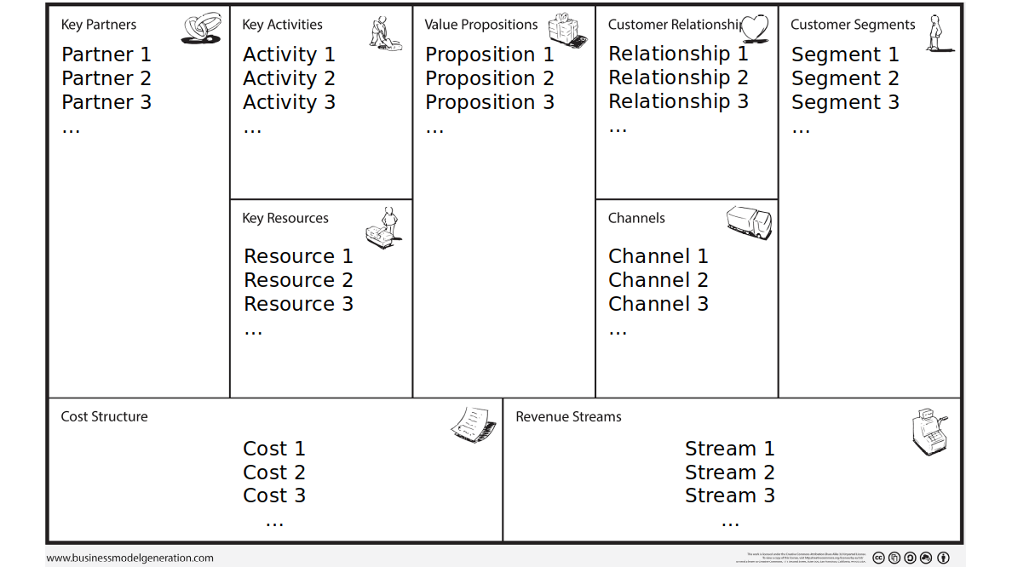
Publisher
Maintenance
Mass customers
Book enthusiasts
Books
Marketing
Built-in “Lock-in”
Advisor
Bloggers and authors
Manufacturer
Distribution
Built-in “Lock-in”
Dev
Developers
Publishing opening
Manufacture
Distribution service
Robust content
Developing platform
Main website
Software developers
Book delivering
Storage
Backdoor website
Distribution
Periodic book selling
Book affiliates
Premium account
Software development
API Subscription

